Slide 1
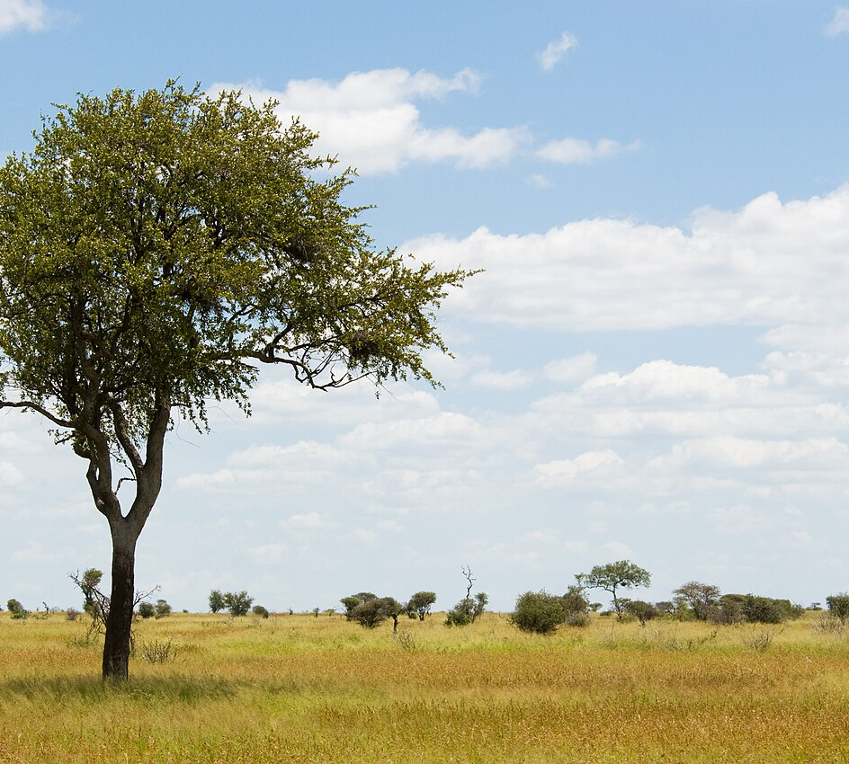
Agricultural Emissions
Regression Analysis
Predicting Temperature from Emission Features
Random Forest Outperforms Linear Models
September 2025

Slide 2


Project Objectives & Research Questions
Primary Research Question Can we predict average temperature changes using agricultural emission features, and which machine learning model performs best?
Analyze FAO/IPCC emission data (1990–2020)
Compare linear and ensemble models
Identify key emission drivers
Provide actionable climate policy insights

Slide 3





Dataset Overview & Key Statistics
Original Shape: 6,965 rows × 31 columns
Feature Category | Key Examples
Fire Emissions | Savanna fires, Forest fires
Agricultural Practices | Crop residues, Rice cultivation
Food System | Food transport, Processing
Manufacturing | Fertilizers manufacturing, IPPU
Land Use | Forestland, Net forest conversion
Cleaned Shape: 6,965 rows × 30 features
Time Period: 1990–2020
Geographic Coverage: Multiple countries/regions
Target Variable: Average Temperature (°C)

Slide 4
Data Cleaning & Preparation
1
2
3
4
Missing Data
Imputation
Feature Engineering
Quality Assurance
Drop rows with missing target
Median for numeric features
Label encode Area variable
Validate consistency
Scale features for models
Maintain 6,965 rows
Remove features with >30% missing
Preserve distribution
Missing Target Values
Removed
Final Feature Count
30
Data Completeness
High

Slide 5



Exploratory Data Analysis Highlights
Feature | VIF Score | Level
Total Emissions | 401,482 | Extremely High
IPPU | 85,995 | Very High
Net Forest Conversion | 73,478 | Very High
Population Variables | 9,000–10,000 | Moderate
Fire emissions strongly correlate with higher temperatures
Forestland shows negative correlation (carbon sink)
Agricultural practices significantly impact temperature
Population variables exhibit complex relationships

Slide 6
Model Comparison Overview
Baseline Mean
Linear Regression
Lasso / Ridge
Random Forest
R²: -0.002
R²: 0.318
R²: 0.317 / 0.315
R²: 0.602
MAE: 0.434
MAE: 0.348
MAE: 0.349 / 0.349
MAE: 0.254
RMSE: 0.560
RMSE: 0.462
RMSE: 0.462 / 0.463
RMSE: 0.353
Random Forest captures non‑linear relationships, providing a substantial boost over linear models.

Slide 7




Random Forest Setup & Tuning
Hyperparameter | Values Tested
n_estimators | 200, 400
max_depth | None, 10, 20
min_samples_split | 2, 5
min_samples_leaf | 1, 2
Optimisation Methodology • 3-fold GridSearchCV
• R² as scoring metric
• 30 features considered
Random Forest Advantages
Handles non‑linear relationships
Built‑in feature importance
Robust to outliers
Reduces overfitting via ensemble

Slide 8
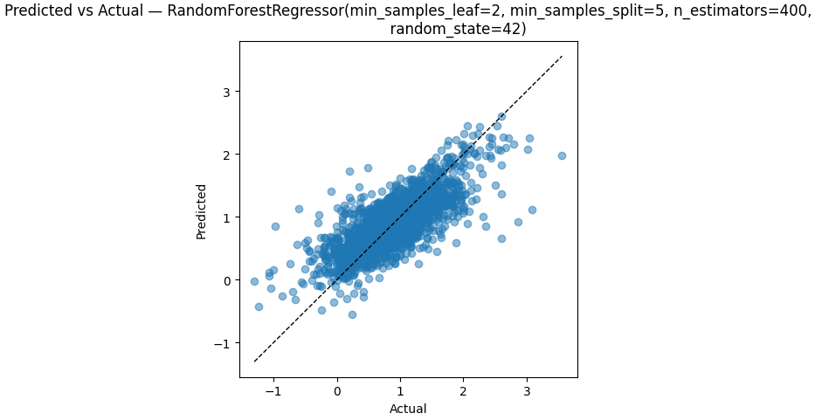
Random Forest Performance
 | Linear Regression | Random Forest | Improvement
R² | 0.318 | 0.602 | +89.3%
MAE | 0.348 | 0.254 | -27.0%
RMSE | 0.462 | 0.353 | -23.6%
R²
0.602
MAE
0.25°C
Predicted vs Actual
RMSE
0.35°C

Slide 9



Feature Importance Analysis
Year and manure application are strongest predictors
Agricultural practices drive warming
Food system logistics contribute meaningfully
Forestland preservation cools the climate

Slide 10
Additional EDA: Distribution & Correlations
Year exhibits the strongest positive relationship (r ≈ 0.55)
Food Transport and Retail show moderate positive correlations (~0.07)
IPPU and Food Household Consumption exhibit small positive correlations (~0.06)
Several variables have weak linear relationships but interact non‑linearly
These insights guide feature engineering and model selection
[2] [4]

Slide 11
Diagnostics & Conclusion
Normality tests (Shapiro‑Wilk) reveal all features deviate from normality (p ≈ 0)
Residual analysis for Random Forest shows a random scatter around zero, suggesting good fit
Linear models are limited by non‑normal features and multicollinearity; regularisation improves but still underperforms
Random Forest provides the best performance (R² ≈ 0.60, MAE ≈ 0.25 °C, RMSE ≈ 0.35 °C)
Continued investigation of feature interactions and temporal dynamics will further enhance predictive accuracy
[2] [5]

Slide 12



Key Insights & Recommendations
Fire management is critical for controlling temperature spikes
Fire Management (High)
Sustainable Agriculture (High)
Invest in early detection and suppression; enforce controlled burns to prevent large-scale fires.
Adopt low‑emission practices like crop rotation, conservation tillage and efficient irrigation.
Sustainable agriculture reduces emissions
Optimising transport can lower food system footprint
Forest conservation offers natural cooling
Transport Optimisation (Medium)
Forest Conservation (High)
Improve logistics, shift to lower‑carbon modes and reduce food miles.
Protect existing forests and support reforestation efforts to enhance carbon sinks.

Slide 13






Limitations & Future Work
Limitations
Future Work
Data quality constraints and missing features
Enhanced Data Integration Include socioeconomic, soil and meteorological variables for deeper insights.
Geographic heterogeneity not fully captured
Regional Modelling Develop models tailored to local climates and regions.
Model interpretability remains limited
Temporal Analysis Incorporate temporal dynamics through time series or recurrent networks.
Temporal autocorrelation not explicitly modelled
Real‑time Integration Leverage real‑time satellite sensors for dynamic predictions.
Expected Impact: This research lays a data‑driven foundation for climate policy decisions, demonstrating the power of Random Forest models to uncover actionable emission drivers.

Slide 14
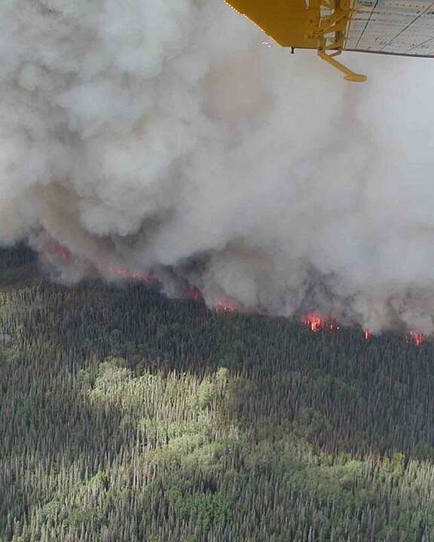
Thank You!
Random Forest modelling identifies actionable emission sources and outperforms linear approaches by 41.5%.
Agricultural Emissions Regression Analysis September 2025

